Slide 1
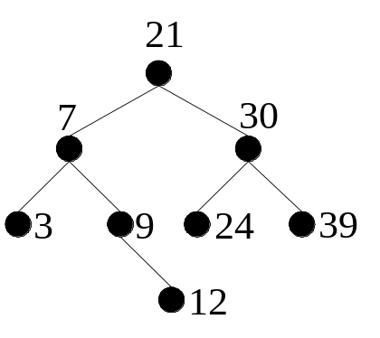
Binary Search Trees II
Ordered Tree
InsertItem
RemoveItem
Recap
Binary Search Tree – Ordered Tree, fast searches
developed a tree node Class and a Binary Search Tree Class.
InsertItem method
Use recursion to implement Traversal techniques, e.g. InOrder
Aims
Design and implementation of RemoveItem

Slide 2
Removing an Item
private void insertItem(T item , ref Node<T> tree)
{
if ( tree == null )
tree = new Node<T>(item);
else if ( item.CompareTo( tree.Data )< 0 )
insertItem( item, ref tree.Left );
else if ( item.CompareTo( tree.Data ) >0 )
insertItem( item, ref tree.Right );
}
public void InsertItem (T item)
{ insertItem( item, ref root ); }
e.g. Remove 7
First step?
Search for item
Already did this with InsertItem

Slide 3
Removing an Item
Once item found – what needs to be done?
e.g. remove 7 from tree
May have 0,1 or 2 subtrees
Number of cases to deal with

Slide 4
Case1: No subTree
Case 1
  Removed a leaf (e.g. 12)
  Subtree is empty
  What needs to be done?
  tree set to null
  tree passed by ref
9
tree
12
9
tree
null

Slide 5
Case2: 1 Subtree
Case 2
  Removed node with only 1 child (e.g. 9)
  1 Subtree is empty
  What needs to be done?
  Tree replaced with its subtree
  Right subtree of 7 becomes right subtree of 9
7
tree
9
12
7
tree
12

Slide 6
Case3: 2 subTrees
Case 3
  Remove node with 2 children (e.g. 7)
  2 non empty Subtrees
  What needs to be done?
  Subtree items need merging into 1 tree
  Merged tree must be a BSTree
tree
21
7
9
3
9
12
12
3
9
12

Slide 7
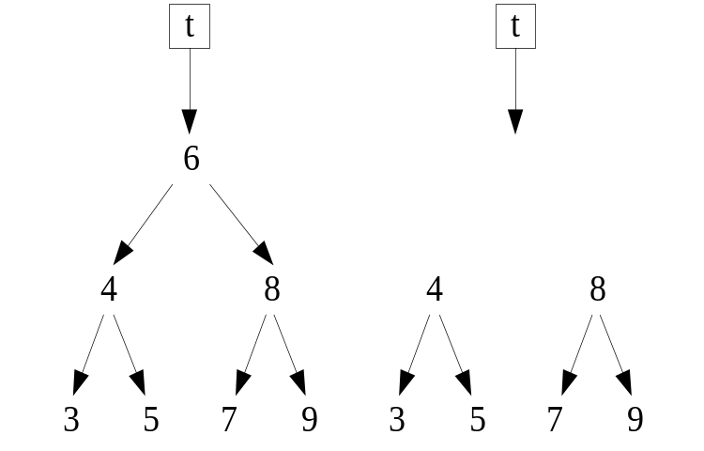
Merge subtrees: Different Methods
Method 1
Pre-order traverse one sub-tree into a list, then insert each item into the other sub-tree; i.e. insert [4, 3, 5] into the sub-tree whose root is 8.
wasteful and will increase the height of the tree.
Method 2
Attach one sub-tree to the correct leaf in the other. That is, attach sub-tree 4 as the left sub-tree of 7, or attach sub-tree 8 as the right sub-tree of 5.
gives the same tree as method 1, though may require fewer constructions.

Slide 8
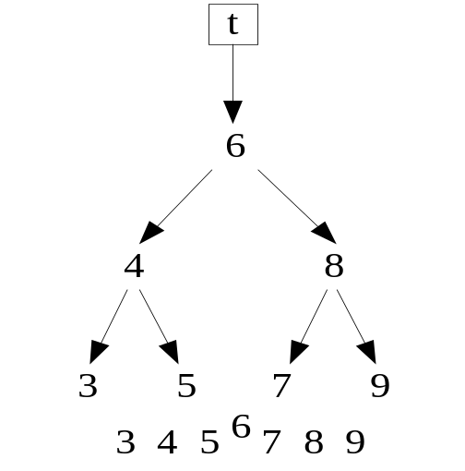
Merge subTrees: Best Method

Slide 9
Merge subTrees: Best Method
Method 3
Leave the two sub-trees as they are. Replace removed item (6) with another value from the tree and then remove that value instead.
Suitable values will be the values that come immediately before and immediately after 6. Use of either of these values will preserve the ordering in the tree.
Either largest from left subTree (i.e. 5)
Or Smallest from Right SubTree (i.e. 7)
we’ll do the latter, giving
7
4
8
5
9
3

Slide 10

Merge SubTrees Algorithm
newRoot = smallestItem in RightSubTree of tree
tree.Data = newRoot
tree.Right= tree.Right with newRoot removed
tree.Left stays as it is
tree
tree
7
6
t.Left
8
4
8
4
t.Right
7
9
5
9
3
5
3
newRoot

Slide 11
Implementation
Pseudocode
removeItem ( T item, ref tree )
if tree ==null do nothing
if item < t.Data
removeItem ( item, ref tree.Left )
//repeat for right subtree
………………………
Algorithm
Remove item from tree
If tree is empty do nothing
recursively search for item
Look left if item < tree.Data
Look right if item > tree.Data
Found Item – look at left and right
If left is empty then tree = right
If right is empty then tree = left
Else
find smallest item in right
tree.Data = smallestItem, remove it from tree’s rightSubTree

Slide 12
Implementation
Pseudocode
removeItem ( T item, ref tree )
if tree ==null do nothing
if item < t.Data
removeItem ( item, ref tree.Left )
//repeat for right subtree
………………………
//found item
if item == tree.Data
// consider ALL cases
Algorithm
Remove item from tree
If tree is empty do nothing
recursively search for item
Look left if item < tree.Data
Look right if item > tree.Data
Found Item – look at left and right
If left is empty then tree = right
If right is empty then tree = left
Else
find smallest item in right
tree.Data = smallestItem, remove it from tree’s rightSubTree

Slide 13
Implementation
Pseudocode
removeItem ( T item, ref tree )
if tree ==null do nothing
if item < t.Data
removeItem ( item, ref tree.Left )
//repeat for right subtree
………………………
//found item
if item == tree.Data
// consider ALL cases
//only right child
if tree.Left==null & tree.Right !=null
tree = tree.Right
Algorithm
Remove item from tree
If tree is empty do nothing
recursively search for item
Look left if item < tree.Data
Look right if item > tree.Data
Found Item – look at left and right
If left is empty then tree = right
If right is empty then tree = left
Else
find smallest item in right
tree.Data = smallestItem, remove it from tree’s rightSubTree

Slide 14
Implementation
Pseudocode
removeItem ( T item, ref tree )
if tree ==null do nothing
if item < t.Data
removeItem ( item, ref tree.Left )
//repeat for right subtree
………………………
//found item
if item == tree.Data
// consider ALL cases
//only right child
if tree.Left==null & tree.Right !=null
tree = tree.Right
// only left child
Algorithm
Remove item from tree
If tree is empty do nothing
recursively search for item
Look left if item < tree.Data
Look right if item > tree.Data
Found Item – look at left and right
If left is empty then tree = right
If right is empty then tree = left
Else
find smallest item in right
tree.Data = smallestItem, remove it from tree’s rightSubTree

Slide 15
Implementation
Pseudocode
removeItem ( T item, ref tree )
if tree ==null do nothing
if item < t.Data
removeItem ( item, ref tree.Left )
//repeat for right subtree
………………………
//found item
if item == tree.Data
// consider ALL cases
//only right child
if tree.Left==null & tree.Right !=null
tree = tree.Right
// only left child
// ……………….
Algorithm
Remove item from tree
If tree is empty do nothing
recursively search for item
Look left if item < tree.Data
Look right if item > tree.Data
Found Item – look at left and right
If left is empty then tree = right
If right is empty then tree = left
Else
find smallest item in right
tree.Data = smallestItem, remove it from tree’s rightSubTree

Slide 16
Implementation
Pseudocode
removeItem ( T item, ref tree )
if tree ==null do nothing
if item < t.Data
removeItem ( item, ref tree.Left )
//repeat for right subtree
………………………
//found item
if item == tree.Data
// consider ALL cases
//only right child
if tree.Left==null & tree.Right !=null
tree = tree.Right
// only left child
// ……………….
// both child
T newRoot = leastItem ( tree.Right )
tree.Data = newRoot
removeItem( newRoot, ref tree.Right )
Algorithm
Remove item from tree
If tree is empty do nothing
recursively search for item
Look left if item < tree.Data
Look right if item > tree.Data
Found Item – look at left and right
If left is empty then tree = right
If right is empty then tree = left
Else
find smallest item in right
tree.Data = smallestItem, remove it from tree’s rightSubTree

Slide 17
LeastItem

Slide 18
LeastItem
It is a BS Tree

Slide 19
LeastItem
Find and return leftmost Item
leastItem(tree) Algorithm
if tree.Left is empty
return tree.Data
else
return leastItem in tree.Left
end if

Slide 20
Summary
Recursive Remove
Find Item to be removed
Look at number of subtrees – use 0, 1 or merge if 2
Uses function leastItem
Swap nodes data value and remove the original node that contained it.

